Slide 1
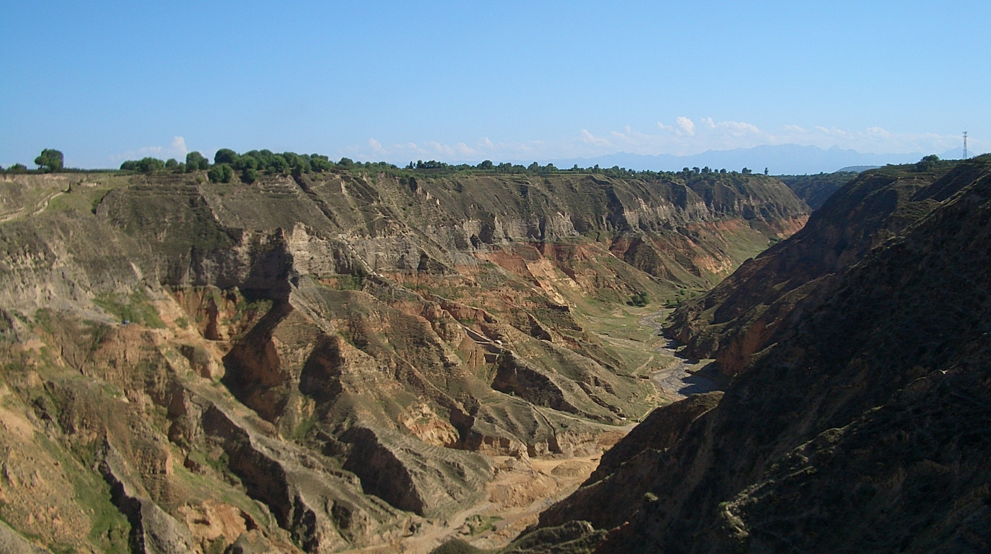
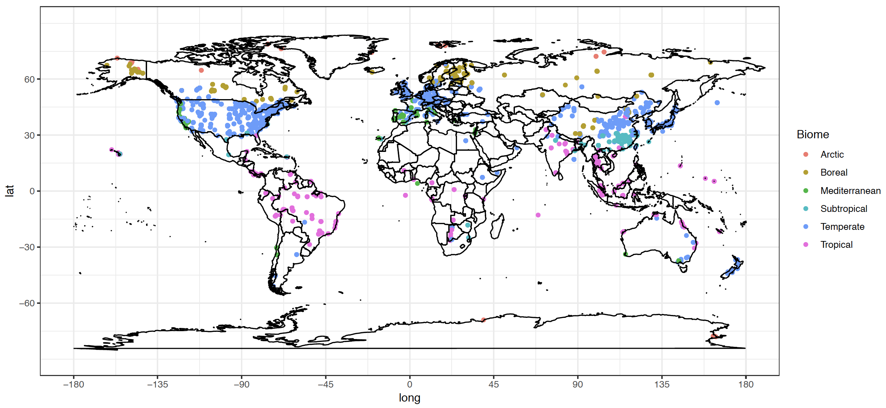
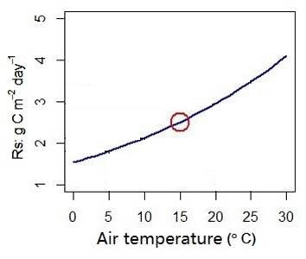
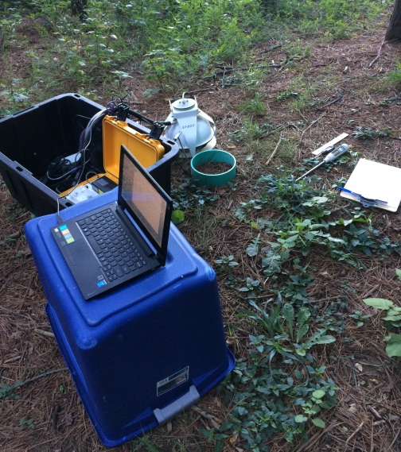
Can soil respiration measured at annual mean temperature represent actual annual soil respiration?
Jinshi Jian
PhD

Slide 2
Background
Simulated sediment yield on 454 US catchments by eight soil erosion models. RUSLE = Revised Universal Soil Loss Equation; CREAMS = Chemicals, Runoff and Erosion from Agricultural Management Systems; WEPP = Water Erosion Prediction Project; tRIBS-Erosion = Triangulated Irregular Network-based Real-time Integrated Basin Simulator soil erosion (Tan et al., 2018).
Bond-Lamberty, B.P., and A.M. Thomson. 2018. A Global Database of Soil Respiration Data, Version 4.0. ORNL DAAC, Oak Ridge, Tennessee, USA.https://doi.org/10.3334/ORNLDAAC/157

Slide 3
Method

Slide 4
Results

Slide 5
Results

Slide 6
Results

Slide 7
Results

Slide 8
Results

Slide 9
Results

Slide 10
Results

Slide 11
Results

Slide 12
Results

